Slide 2
Unit-7
What is VHDL ?
VHDL stands for VHSIC (Very High Speed Integrated Circuits) Hardware Description Language. In the mid-1980’s the U.S. Department of Defense and the IEEE (Institute of Electrical and Electronics Engineers) sponsored the development of this hardware description language. Its goal was to develop very high-speed integrated circuit. It has become now one of industry’s standard languages used to describe digital systems. The other widely used hardware description language is Verilog.

Slide 3
Cont…
Both are powerful languages that allow us to describe and simulate complex digital systems. A third HDL language is ABEL (Advanced Boolean Equation Language) which was specifically designed for Programmable Logic Devices (PLD). ABEL is less powerful than the other two languages and is less popular in industry.

Slide 4
Role of HDLs
V
Very High Speed Integrated Circuit
H
Hardware
D
Description
L
Language
System description and documentation
System simulation
System synthesis

Slide 5
7.1. RTL design with VHDL
Register Transfer Level, or RTL design lies between a purely behavioral description of the desired circuit and a purely structural one. An RTL description describes a circuit’s registers and the sequence of transfers between these registers but does not describe the hardware used to carry out these operations.
The steps in RTL design are:
determine the number and sizes of registers needed to hold the data used by the device.
determine the logic and arithmetic operations that need to be performed on these register contents, and
design a state machine whose outputs control how the register contents are updated in order to obtain the desired results.

Slide 6
Cont…
Producing an RTL design is similar to writing a computer program in a conventional programming language. Choosing registers is the same as choosing variables. Designing the flow of data in the “data path” is analogous to writing expressions involving the variables (registers) and operators (combinational functions). Designing the controller state machine is similar to deciding on the flow of control within the program (if/then/else, while-loops, etc).

Slide 7
Cont…
In digital circuit design, register-transfer level (RTL) is a design abstraction which models a synchronous digital circuit in terms of the flow of digital signals (data) between hardware registers , and the logical operations performed on those signals. It is used in hardware description languages (HDLs) like Verilog and VHDL to create high-level representations of a circuit. From this lower-level representations and finally actual wiring can be derived. Design at the RTL level is typical practice in modern digital design.

Slide 8
Cont….
` When designing digital integrated circuits with a hardware description language, the designs are usually engineered at a higher level of abstraction than transistor level (logic families) or logic gate level. In HDLs, the designer declares the registers (which roughly correspond to variables in computer programming languages), and describes the combinational logic by using constructs that are familiar from programming languages such as if-then-else and arithmetic operations. This level is called register-transfer level. The term refers to the fact that RTL focuses on describing the flow of signals between registers.

Slide 9
RTL vs HDL? Whats the difference ?
HDL is the catch all name for all hardware description languages (Verilog,VHDL, etc.) in the same way Object Oriented can refer to C++, Java, etc. RTL, on the other hand, is a way of describing a circuit. You write your RTL level code in an HDL language which then is translated (by synthesis tools) to gate level description in the same HDL language or whatever your target device/process will take.

Slide 10
Cont….
Here is a line of Verilog (HDL) describing a mux in RTL:
assign mux_out = (sel) ? din_1 : din_0;
Your synthesis tool can take that and convert it to a set of logic gates, or just a mux macro that is supported by your end device. For example it might instantiate a mux macro
mux u3 (mux_out, din_1, din_0);

Slide 11
7.3. Shape (Structure) of VHDL
Shape refers to the typical parts of a single VHDL module. A VHDL module contains two basic parts –( a) one covers the connections made between this module and other modules (the ‘‘outside world’’ which may be the pins on an FPGA package or other modules within the design) and (b) the other part, an unambiguous description of the behavior of the module. Modules may be combined in parallel or hierarchically.

Slide 12
Cont…
In the case of a module, the only information from the outside world or higher level that this module can access (either see or modify) is listed in the entity statement. Other information can be defined in both the entity and the architecture sections and can be used freely within this module. If modules hierarchically lower than this module are to share this information, it must be explicitly declared in that module’s entity statement.

Slide 13
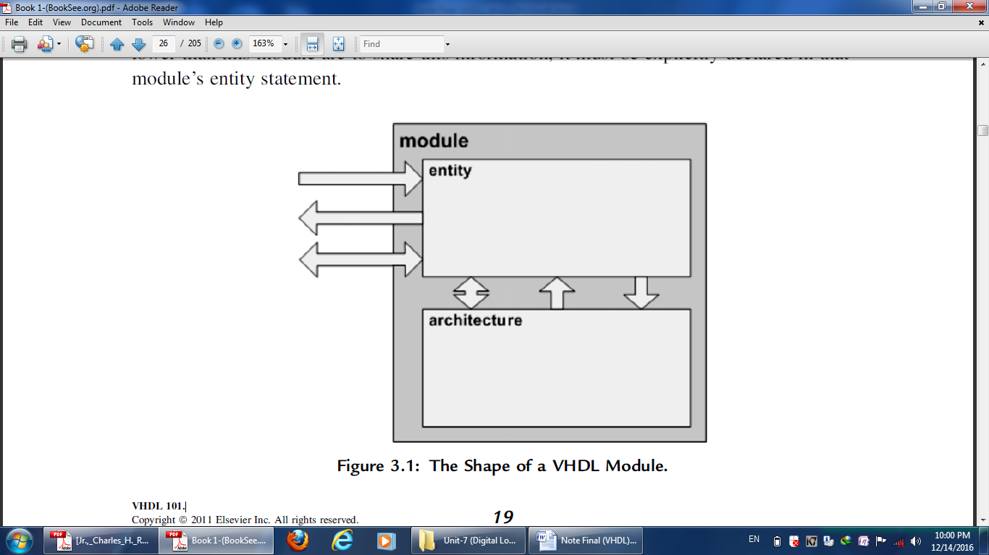
Cont…

Slide 14
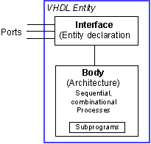
Each entity is modeled by an entity declaration and an architecture body. We can consider the entity declaration as the interface to the outside world that defines the input and output signals, while the architecture body contains the description of the entity and is composed of interconnected entities, processes and components, all operating concurrently.

Slide 15
Cont…
VHDL uses reserved keywords that cannot be used as signal names or identifiers. Keywords and user-defined identifiers are case insensitive. Lines with comments start with two adjacent hyphens (--) and will be ignored by the compiler. VHDL also ignores line breaks and extra spaces. VHDL is a strongly typed language which implies that one has always to declare the type of every object that can have a value, such as signals, constants and variables.

Slide 16
Data Types
There are four classes of data types: scalar, composite, access and file types. The scalar types represent a single value and are ordered so that relational operations can be performed on them. The scalar type includes integer, real, and enumerated types of Boolean and Character.

Slide 17
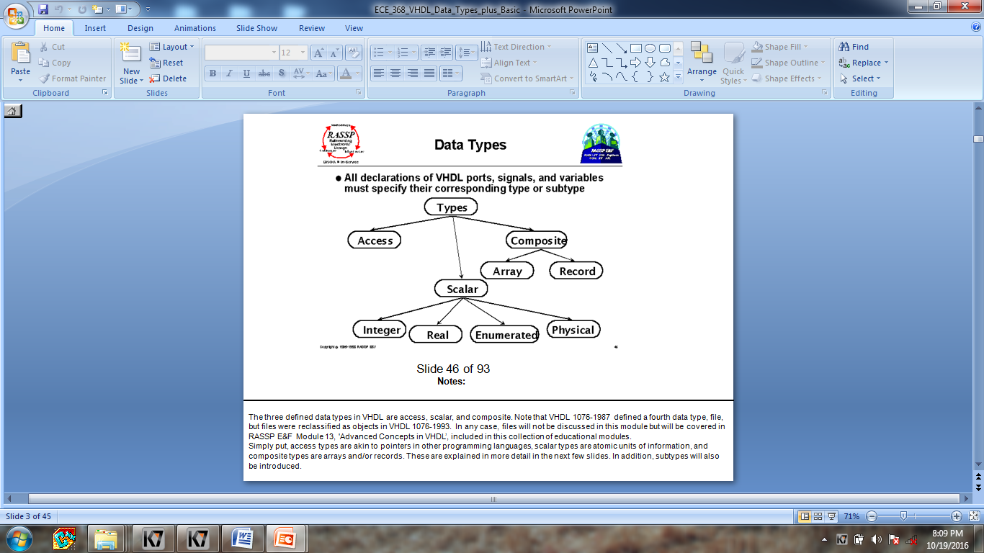

Slide 18
What is a process ?
A process statement is a concurrent statement, but all statements contained in it are sequential statement (statements that executes serially, one after the other).
The use of processes makes your code more modular, more readable, and allows you to separate combinational logic from sequential logic.
List of all signals that the process is sensitive to. Sensitive means that a change in the value of these signals will cause the process to be invoked.

Slide 19
VHDL Object Types
Constants
Signals: It is a physical signal (you can think of it like a piece of wire. A signal is a sequence of time-value pairs. A signal assignment takes effect only after a certain delay (the smallest possible delay is called a “delta time”). It is possible to define global signals (signals that can be shared among entities). But more often signals are just locally defined for a given architecture
Variables: Assignment to variables are scheduled immediately (the assignment takes effect immediately). If a variable is assigned a value, the corresponding location in memory is written with the new value while destroying the old value. This effectively happen immediately so if the next executing statement in the program uses the value of the variable, it is the new value that is used. Typically, variables are used as a local storage mechanism, visible only inside a process.
Files

Slide 20
Signals vs. Variables
Signals assignments are scheduled after a certain delay d
Variables assignments happen immediately, there is no delay

Slide 21
Attributes
Types and objects declared in a VHDL description can have additional information, called attributes, associated with them. In other words, attributes provide information about certain items in VHDL. They may be used to communicate information about many different items in VHDL. Similarly, attributes can return various types of information. For example, an attribute can be used to determine the depth of an array, its range, its leftmost index, etc. Additionally, the user may define new attributes to cover specific situations. This capability allows user-defined constructs and data types to use attributes. An example of the use of attributes is in assigning information to a VHDL construct, such as board location, revision number, etc.

Slide 22
Finite State Machine (FSM)
The FSMs consist of three parts: state register, next-state logic, and output logic
Loop Statement
[ loop-label : ] iteration-scheme loop
sequential-statements
end loop [ loop-label ] ;
There are three types of iteration schemes. The first is the for iteration scheme that has the form
for identifier in range
An example of this iteration scheme is
FACTORIAL := 1;
for NUMBER in 2 to N loop
FACTORIAL := FACTORIAL * NUMBER;
end loop;

Slide 23
Cont…
The body of the for loop is executed (N-1) times, with the loop identifier, NUMBER, being incremented by I at the end of each iteration. The object NUMBER is implicitly declared within the for loop to belong to the integer type whose values are in the range 2 to N. No explicit declaration for the loop identifier is, therefore, necessary. The loop identifier, also, cannot be assigned any value inside the for loop. If another variable with the same name exists
outside the for loop, these two variables are treated separately and the variable used inside the for loop refers to the

